Slide 1



Indian Premier League (IPL) 2024
Presented For: Sportsbasic

Slide 2

The Problem Statement
Sports Basics is a sports blog company that entered space recently. They wanted to get more traffic to their website by releasing a special edition magazine on IPL 2024.
This magazine aims to provide interesting insights and facts for fans, analysts and teams based on the last 3 years' data.
The chief editor Tony Sharma oversees this publication, and he believes in data analytics.
He reached out to Peter Pandey, a journalist in his team who is a data savvy cricket enthusiast.

Slide 3
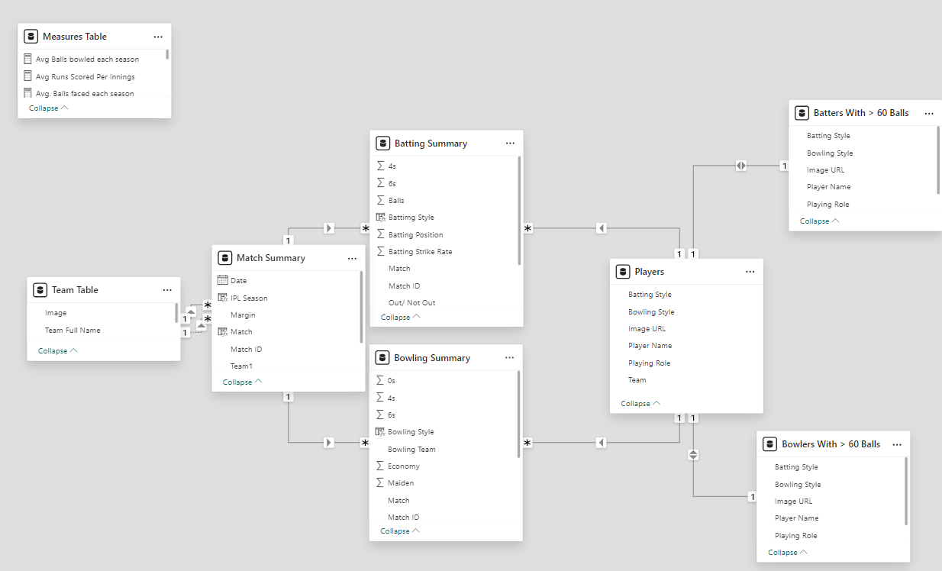
Dataset Overview
2 Fact Tables:
fact_batting_summary
fact_bowling_summary
2 Dimension Tables:
fact_batting_summary
fact_bowling_summary

Slide 4
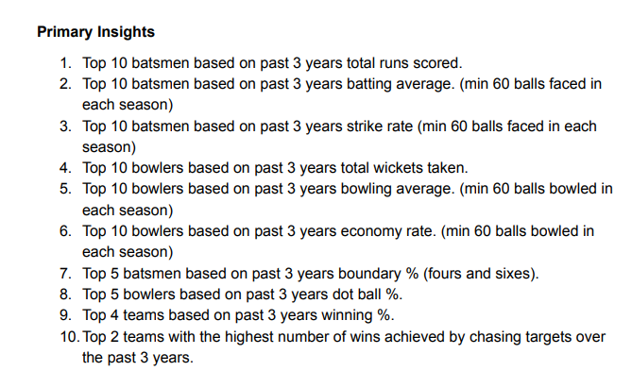
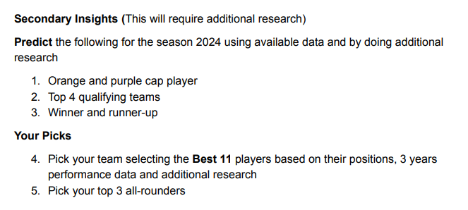

Slide 5


Slide 6
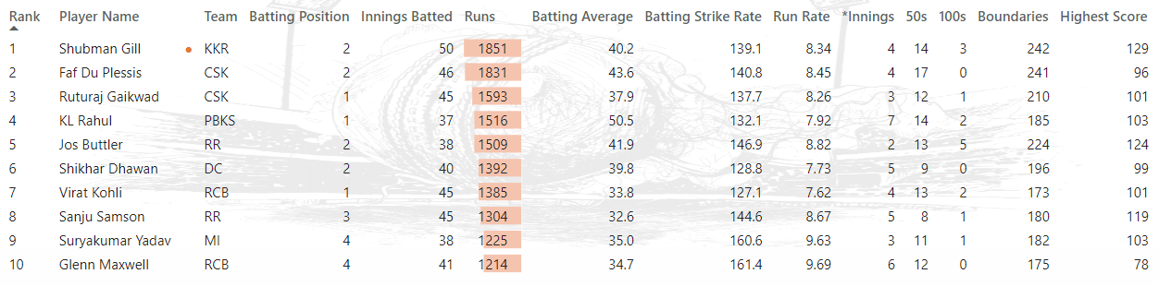
1. Top 10 batsmen based on past 3 years total runs scored.
Shubman Gill leads the chart, followed by Faf du Plessis and Ruturaj
Exceptional high scores coupled with remarkable batting strike rates
Dynamic Trio: Providing an aggressive start to the team while batting
Ability to set the tone early on and build momentum for the innings
Trio's aggressive approach can put the opposition on the back foot from the beginning
Setting a proactive and formidable tone for the team's batting innings

Slide 7
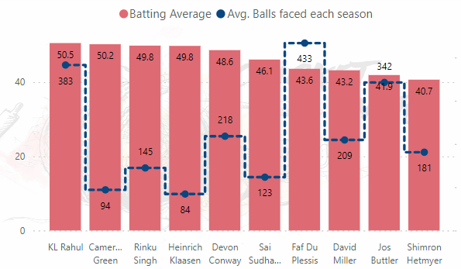
2. Top 10 batsmen based on past 3 years batting average. (min 60 balls faced in each season)
KL Rahul maintains the best batting average among players facing more than 383 deliveries
Consistent performance and ability to anchor the innings effectively
Rahul's presence ensures a solid foundation for the team's batting lineup
Crucial player for maintaining momentum and stability throughout the innings

Slide 8
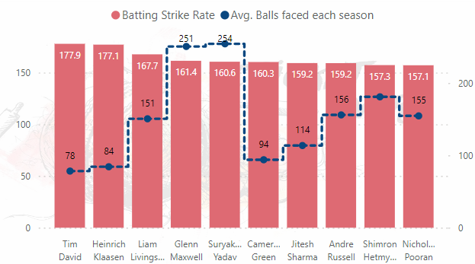
3. Top 10 batsmen based on past 3 years strike rate (min 60 balls faced in each season)
Tim David and Heinrich Klaasen top the chart with exceptionally high strike rates
Displaying aggressive intent and ability to accelerate the scoring rate effectively
Pair's aggressive approach can put pressure on the opposition and dictate the pace of the game
Valuable assets for injecting momentum and energy into the team's batting lineup

Slide 9
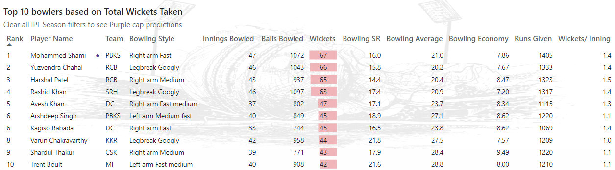
4. Top 10 bowlers based on past 3 years total wickets taken.
Mohammed Shami, Yuzvendra Chahal, Harshal Patel, and Rashid Khan stand out as versatile bowlers with a blend of wicket-taking ability and economical bowling
Crucial assets in maintaining pressure, picking up key wickets, and contributing significantly to their team's success

Slide 10
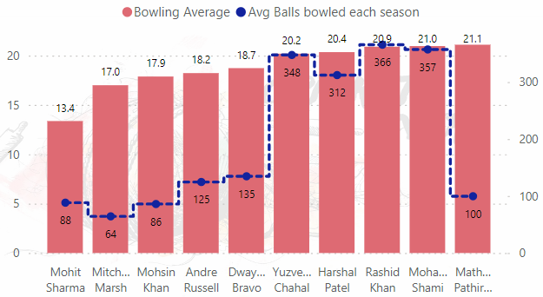
5. Top 10 bowlers based on past 3 years bowling average. (min 60 balls bowled in each season)
Mohit Sharma boasts the lowest bowling average among the group
Shami, Chahal, and Rashid Khan maintain commendable bowling averages despite high ball count

Slide 11
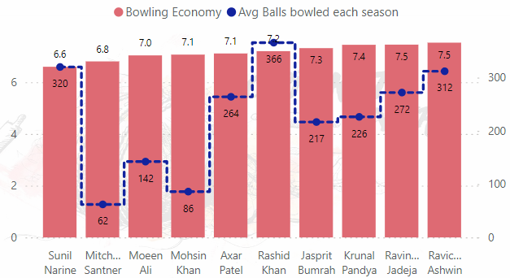
6. Top 10 bowlers based on past 3 years economy rate. (min 60 balls bowled in each season)
Sunil Narine emerges as the standout performer with the lowest bowl economy in the competition
Demonstrating remarkable control and efficiency in restricting the flow of runs

Slide 12
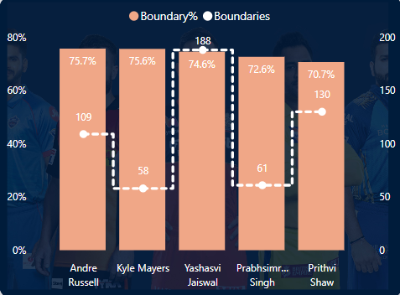
7. Top 5 batsmen based on past 3 years boundary % (fours and sixes).
Andre Russell's proficiency in scoring runs via boundaries cements his reputation as a dynamic and impactful batsman.
A game-changer whose boundary-hitting prowess can turn the tide of a match in favor of his team.

Slide 13
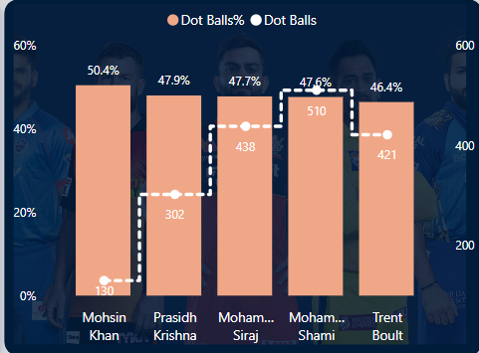
8. Top 5 bowlers based on past 3 years dot ball %.
Moshin Khan stands at the top of the chart for his exceptional bowling performances.
Mohammed Shami and Mohammed Siraj also maintain high dot ball percentages despite bowling a significant number of deliveries.

Slide 14
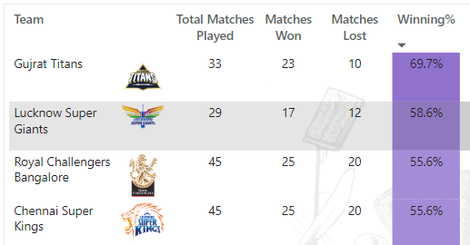




9. Top 4 teams based on past 3 years winning %.

Slide 15


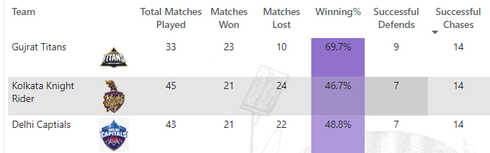
10.Top 2 teams with the highest number of wins achieved by chasing targets over the past 3 years.

Slide 16


Slide 17


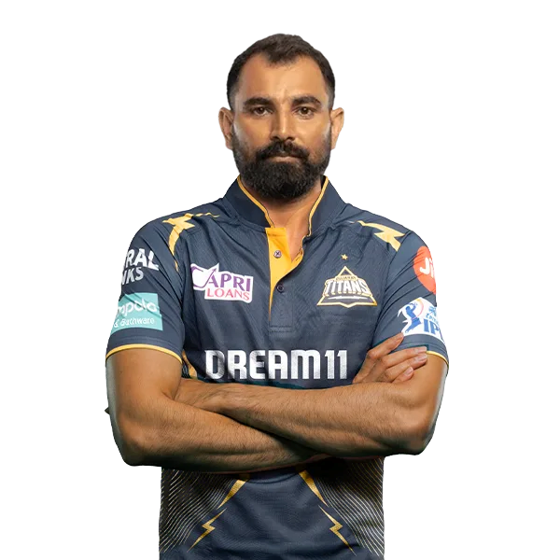
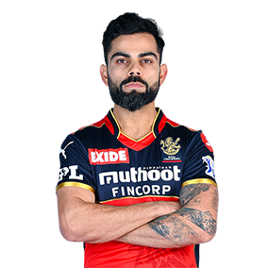
Orange Cap
Purple Cap
Total Runs in last 3 IPL Seasons: 1385
Total Runs in last 3 IPL Seasons: 1385

Slide 18



Qualifiers
Runner-up's
VS

Slide 19
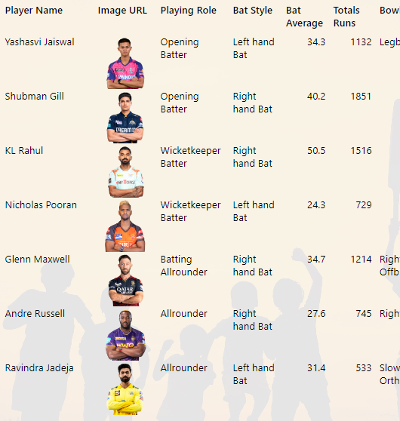
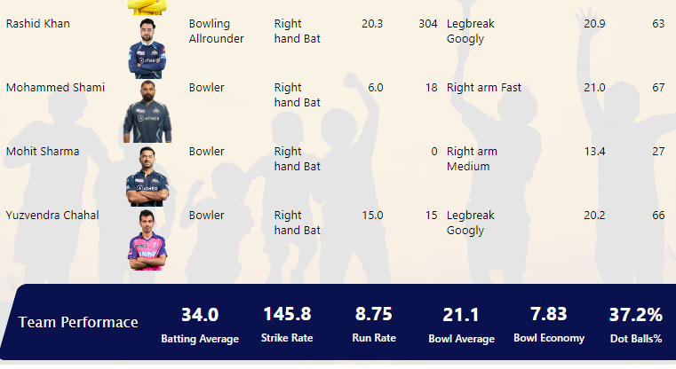
Final 11

Slide 20
